Slide 1
Statistical challenges when examining high-throughput sequencing data
Greg Gloor
Department of Biochemistry
University of Western Ontario
https://github.com/ggloor/compositions/presentations
ggloor@uwo.ca @gbgloor
Notes:
Datasets collected by high-throughput sequencing of amplicons, or shotgun sequencing of metagenomes or metatranscriptomes are commonplace. These datasets are used to study human health and disease, ecological niches, and the built environment. Datasets collected in this way are limited by the capacity of the machine and so are necessarily probabilistic samples of the underlying environment. However, many investigators are either unaware of this or assume specific properties of the data that confound the analyses. This confounding leads to both false positive and false negative results. I will introduce the concept of probabilistic sampling and of compositional data and describe their properites and pathologies. I will provide examples from vaginal meta-transcriptomes and gut metagenomes that demonstrate the general utility of the approach. I will finally give guidance and point to resources and examples for the analysis of microbiome datasets using compositional data analysis.

Slide 2
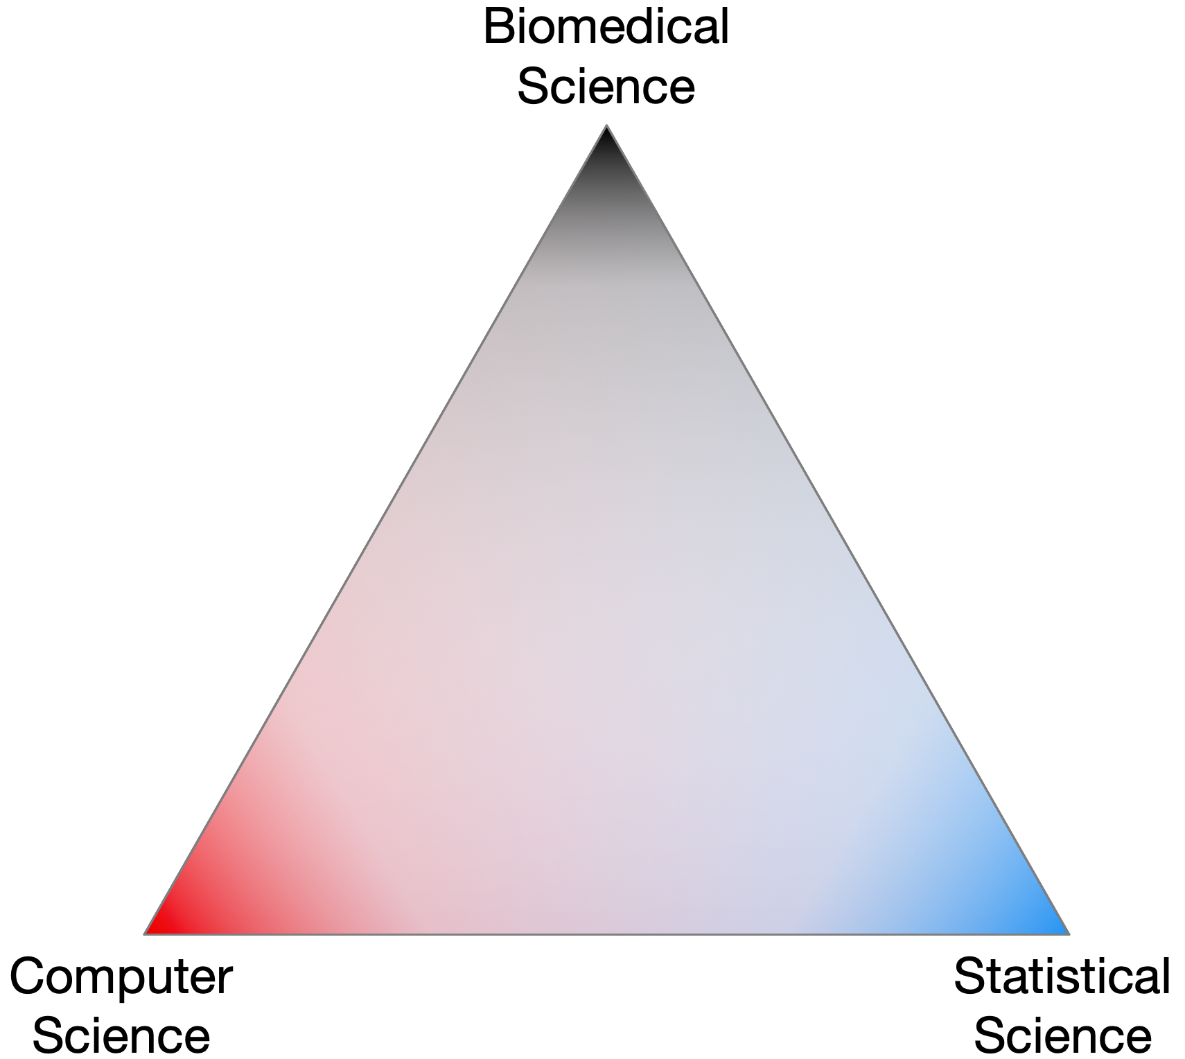
The triangle of trust
Notes:
Complex data and everyone trusts everone else without necessarily having the domain-specific expertise needed

Slide 3
Nobody sees the whole elephant

Slide 4
Researcher degrees of freedom

Slide 5
The sequencing meat grinder

Slide 6
Random data as counts
Example 100 random sample sets
range=1800-2200
range= 8000-12000
range=450-550
🐯
🐞
👽

Slide 7
Same random data as proportions/probabilities
Constant sum of 1000
Constant sum operations:
Sequencing
percentage, relative abundance, probability, proportion
Count normalization
Rarefaction
Gloor, et al. 2016. Ann Epidemiology
Gloor, et al. 2016. Can J. Micro.
Gloor, et al, 2017. Front. Micro.

Slide 8
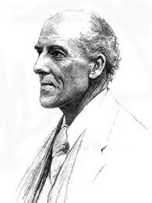
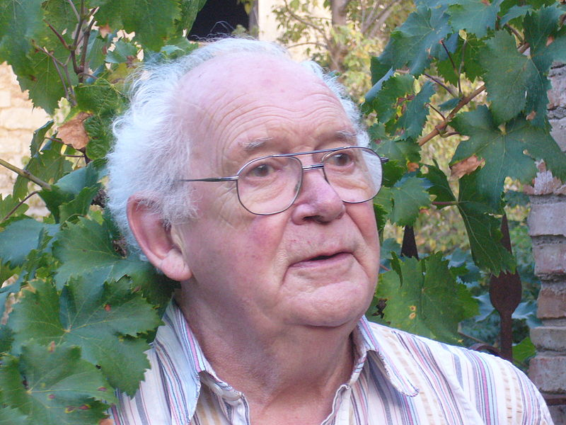
We have CoDa
Compositional data are logically inconsistent with most tools in common use (Pearson 1897)
correlation, PCA etc.
Sequencing, negative binomial, rarefaction, ZIG
Work in log ratios
Aitchison and others
Conceptually similar to qPCR
Aitchison 1986

Slide 9
CoDa properties and *lr
Count
Sequencing
Simplex
27
853
66
740
112
216
Simplex: one fewer dimensions than variables
Problems remain regardless of dimension
*lr(x) = [ log(x₁/g_{X}), log(x₂/g_{X}), … log(x_{D}/g_{X}) ]
X = [ x₁, x₂, … x_{D} ], g_{X} = geometric mean of X (or subset)
Probabilities
Some invariant
Relative values
Multivariate Poisson
Aitchison 1986. Stat. Anal. Comp Data
Pawlowsky-Glahn, 2015. Mod. Anal. CoDa
Notes:
Scale dependence - hence ‘normalization’
Correlation and covariation are unreliable
Addition and subtraction are not useful operations
Subsetting and aggregating are problematic
Sparse data is an issue

Slide 10
Normalization
Data on the simplex and counts are different

Slide 11
Normalization
Data on the simplex and counts are different
The most used normalization is worse than nothing

Slide 12
Normalization
Data on the simplex and counts are different
The most used normalization is worse than nothing
A log-ratio transform does not help much

Slide 13
Distances
Distances in count data do not match up with distances in proportional data
Thus we may not learn anything about the environment from sequencing data
Only exception is Aitchison distance
Euclidian distance on clr
Bray-Curtis
Bray-Curtis DES
Bray-Curtis
Bray-Curtis DES
Proportional
DES normalized
Proportional
DES normalized
Numeric
Numeric
Numeric
Numeric
Jensen-Shannon
Jensen-Shannon DES
Jensen-Shannon
Jensen-Shannon DES
Proportional
DES normalized
Proportional
DES normalized
Numeric
Numeric
Numeric
Numeric
Euclidian clr
Euclidian clr DES
Euclidian clr
Euclidian clr DES
Proportional
DES normalized
Proportional
DES normalized
Numeric
Numeric
Numeric
Numeric

Slide 14
Distance 2: test dataset
O F1 F2 F3
O1 1 2 7 x = 0_{i}/sum(O_{i})
O2 2 1 7 s = O_{i,1:2}/sum(O_{i,1:2})
O3 3 4 3 p = O * [8,1,1]/
O4 4 3 3 (sum(O * [8,1,1])
O F1 F2 F3
O1 1 2 7 x = 0_{i}/sum(O_{i})
O2 2 1 7 s = O_{i,1:2}/sum(O_{i,1:2})
O3 3 4 3 p = O * [8,1,1]/
O4 4 3 3 (sum(O * [8,1,1])

Slide 15
Distance 2: test dataset
O F1 F2 F3
O1 1 2 7 x = 0_{i}/sum(O_{i})
O2 2 1 7 s = O_{i,1:2}/sum(O_{i,1:2})
O3 3 4 3 p = O * [8,1,1]/
O4 4 3 3 (sum(O * [8,1,1])
Distances should be:
Scale invariant (S)
Same distance on proportion and percentage
Sub-compositionally dominant (D)
Same or smaller distance if remove one feature
Permutation invariant (P)
Distance should not change if we rotate the data
O F1 F2 F3
O1 1 2 7 x = 0_{i}/sum(O_{i})
O2 2 1 7 s = O_{i,1:2}/sum(O_{i,1:2})
O3 3 4 3 p = O * [8,1,1]/
O4 4 3 3 (sum(O * [8,1,1])

Slide 16
Distance 2: test dataset
O F1 F2 F3
O1 1 2 7 x = 0_{i}/sum(O_{i})
O2 2 1 7 s = O_{i,1:2}/sum(O_{i,1:2})
O3 3 4 3 p = O * [8,1,1]/
O4 4 3 3 (sum(O * [8,1,1])
O F1 F2 F3
O1 1 2 7 x = 0_{i}/sum(O_{i})
O2 2 1 7 s = O_{i,1:2}/sum(O_{i,1:2})
O3 3 4 3 p = O * [8,1,1]/
O4 4 3 3 (sum(O * [8,1,1])

Slide 17
Summary 1: The CoDa approach
Theoretical foundation
Gives same answer with sequence data and counts
Based on variance not abundance
Internally consistent
Univariate and multivariate approaches agree
Robust
Upstream decisions have less effect
Probabilistic
Matches the data

Slide 18
Sequencing is random sampling
Notes:
Starting with a of molecules composed of Tigers and Ladybugs
We take a random sample, how many Tigers and how many Ladybugs
If we count a given random area we can infer how many off each there are in entire set

Slide 19
Sequencing is a probabilistic sample
Notes:
Starting with a of molecules composed of Tigers and Ladybugs
We take a random sample, how many Tigers and how many Ladybugs
If we count a given random area we can infer how many off each there are in entire set

Slide 20
We need multiple probabilistic samples to approximate truth
Gloor, et al. 2016. Ann Epidemiology
Gloor, et al. 2016. Can J. Micro.
Gloor, et al, 2017. Front. Micro.
Notes:
A 0 count in a sample may be a 0 probability, or it may not. If the feature in any sample has a count greater than 0, then by definition the expected value of the probability in all samples for that feature is greater than 0

Slide 21
aldex.clr function
Estimate technical variation due to random sampling
Convert sample counts to posterior probability distribution of features
MC instances drawn from Dirichlet distribution
Log-ratio transform to get distribution of log-ratio values
Each instance is a valid estimate of what could have been observed for each sample given more sequencing
Fernandes et al. 2013 PLoS One

Slide 22
What is statistically significant? v. what is reliably different?
Notes:
Dataset of 16S OTUs between young adults and school children

Slide 23
What is statistically significant? v. what is reliably different?

Slide 24
P value correlation of subsets of larger dataset

Slide 25
Calculating P values vs. calculating effect size
Separation of means relative to the dispersion scaled by sample size (t statistic)
Separation of means relative to dispersion
(Cohen’s d)

Slide 26
What is statistically significant? v. what is reliably different?

Slide 27
Normalized effect between distributions
Cohen’s d
Parametric, problematic with non-normal data
Difference between means
d_{NEF}
Based on distributions not summary statistics
Small sample sizes distributions from aldex.clr
Large sample sizes distributions from log-ratio transformed data
MSD
Median of δ vector
Robust estimator of location
Applicable to any distribution
MMAD
Median of 𝝈 vector
52% efficient
20% breakdown point
∼1.42 𝝈
d_{NEF}
~0.7 𝜃
Median of 𝜃 vector
Fernandes et al. 2013 PLoS One

Slide 28
Effect size correlates in subsets

Slide 29
Sample sizes v. no effect expected
• Transcriptome Dir/CLR
• 16S Dir/CLR
• 16S CLR only

Slide 30
TP and FP in subsets of whole dataset

Slide 31
FP effect distribution in whole dataset

Slide 32
Graphing d_{NEF}
E > 2
E > 1
E < 1
E > -1
E < -1
E < -2
Gloor et al. 2016 JCGS

Slide 33
Summary 2
Standardized effect sizes give what biologists desire: reproducible differences
d_{NEF}
Robust
Sensitive
Reproducible
FP not a problem at sensible sample sizes
Useful in a variety of dataset types
Metatranscriptome eg. Macklaim et al Microbiome 2014
Transcriptome eg. Goneau MBio 2015
In vitro selection (SELEX) eg. McMurrough PNAS 2014
Metagenomics eg. Almeida Nature 2019
neither
Effect
Size &
P value
P value
Only

Slide 34
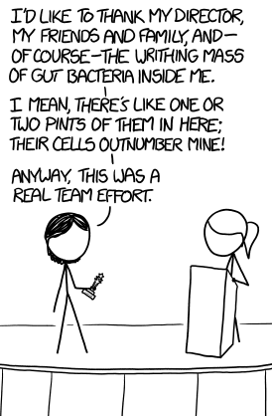



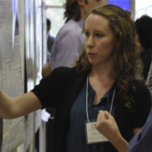



Acknowledgments
Andrew
Fernandes
Jean
Macklaim
Vera Pawlowsky-Glahn
Juan Jose Egozcue
Justin Silverman
philr
Thom Quinn
propr
🐯
🐞
👽
Gregor Reid
Jeremy Burton
Amy McMillan
Daniel Giguere
Jia Rong Wu
Coming soon:
Rob Finn et al.
Mgnify@EBI
Notes:
Many more fragments than we can count

